Slide 1
Language Learning in Hybrid Modality
Asynchronous activities to support language learning
Anna Iacovella,
Language Program Director
Italian Studies Department
Yale University
anna.iacovella@yale.edu

Slide 2
Hybrid & blended Learning
Hybrid learning combines face-to-face and online teaching into one cohesive experience.
Approximately half of the class sessions are on-campus, while the other half have students working online.
Although that may sound like a cut-and-dry formula, a lot of planning is needed to ensure that hybrid works well, allowing its two formats to capitalize on each other’s strengths.
https://www.codlearningtech.org/PDF/hybridteachingworkbook.pdf

Slide 3
Rubio, Fernando, and Joshua J. Thoms. "Hybrid language teaching and learning: Looking forward." (2012): 1-9.
A theoretical model

Slide 4
ITAL130 Pilot Syllabus 4/1 (Fall 2021)
z

Slide 5
ITAL140 Pilot Syllabus 4/1 (Spring 2022)
z

Slide 6
Asynchronous activities & grading

Slide 7
Asynchronous activities listed in the program of study

Slide 9
Cultural reading: comprehension, reflection & discussion

Slide 10
Asynchronous activity
z

Slide 11
Asynchronous Discussion (Canvas Platform)

Slide 12
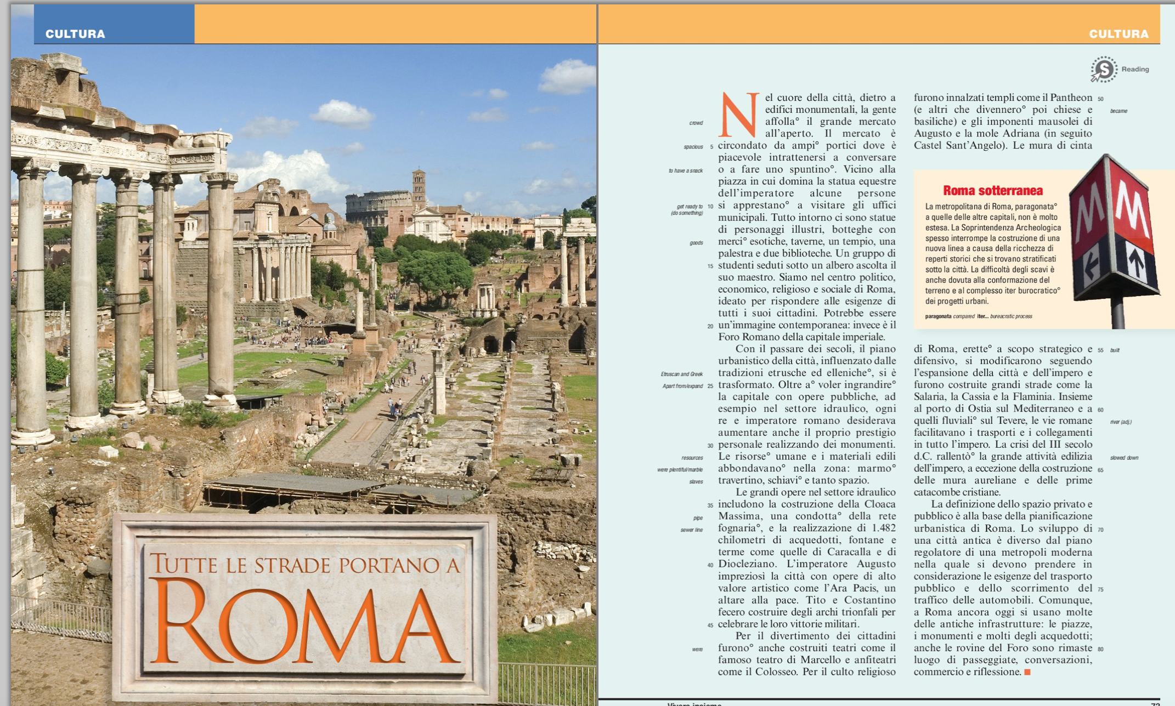
A Cultural Activity

Slide 14
Asynchronous Discussion (Canvas Platform)

Slide 15
Students research a festival or a tradition, of a small town in Italy. They present the event in addition to their personal comments
z

Slide 16
A film activity: Students view the film independently. Then they discuss the film via Voice Thread as a podcast (Voice Thread)
z

Slide 17
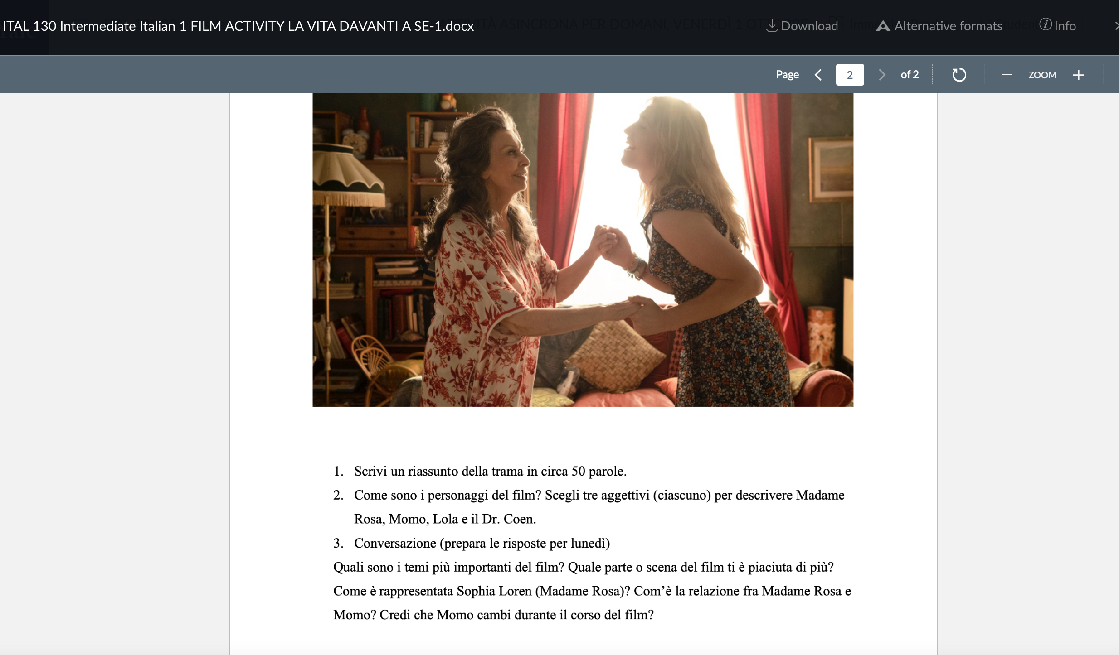
& Questions to stimulate discussion

Slide 18
Literary passages activity: L’amica geniale (My brilliant friend) by Elena Ferrante.

Slide 19
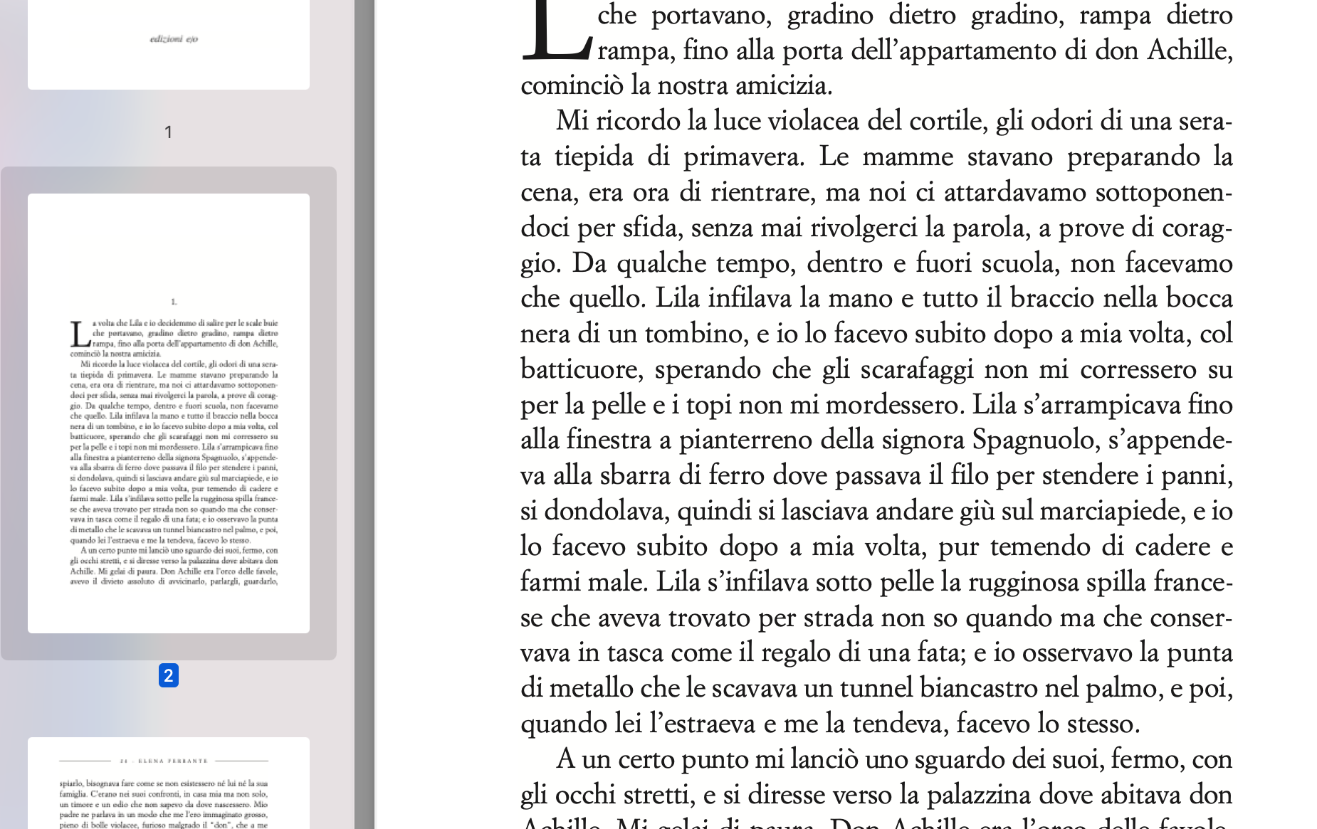
Students read independently. They compile a glossary on a shared google doc and answer questions for discussion as they read the excerpt.

Slide 20
Student-built Glossary

Slide 21
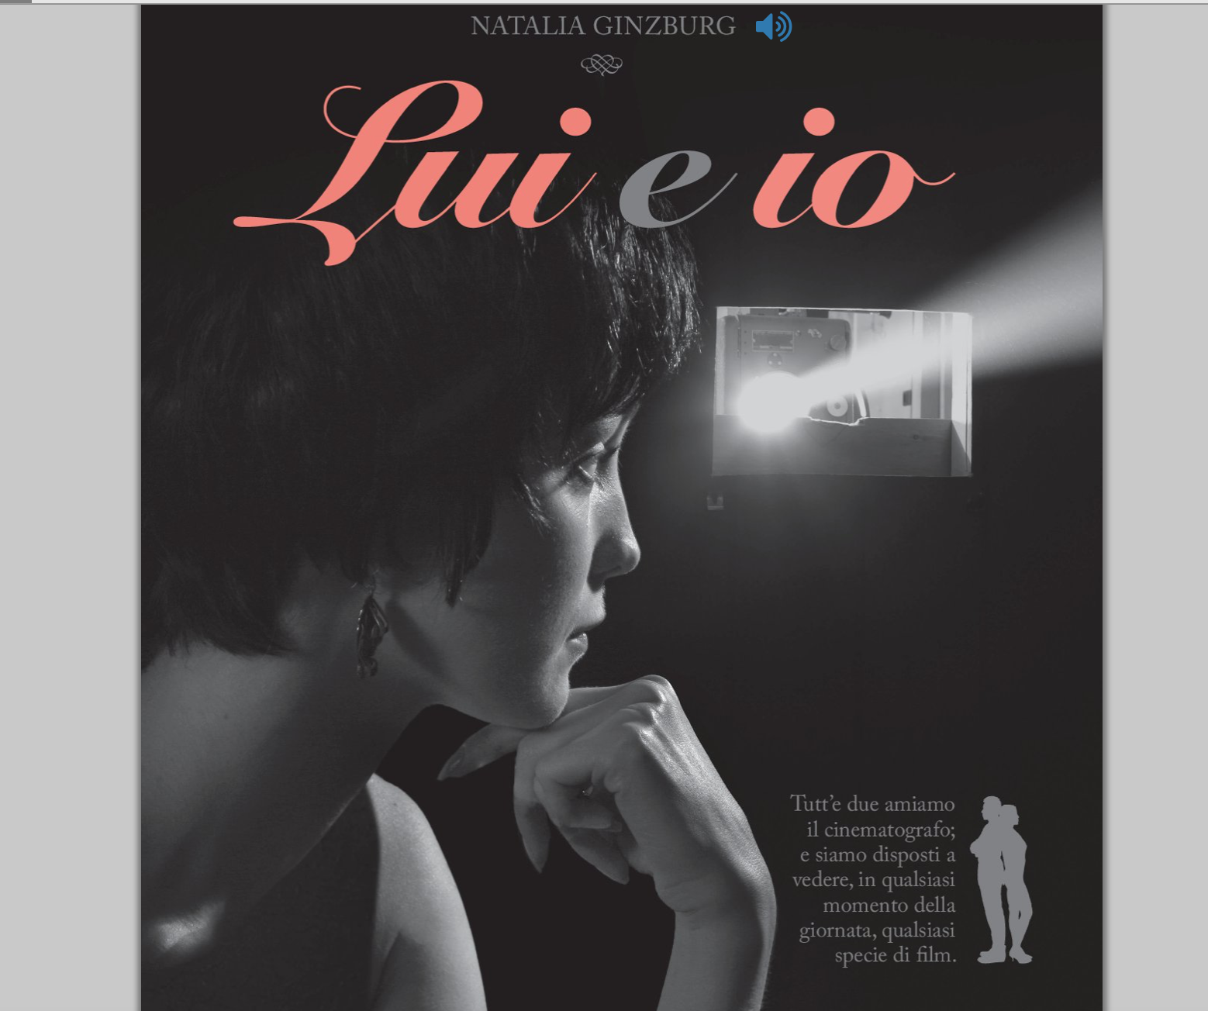
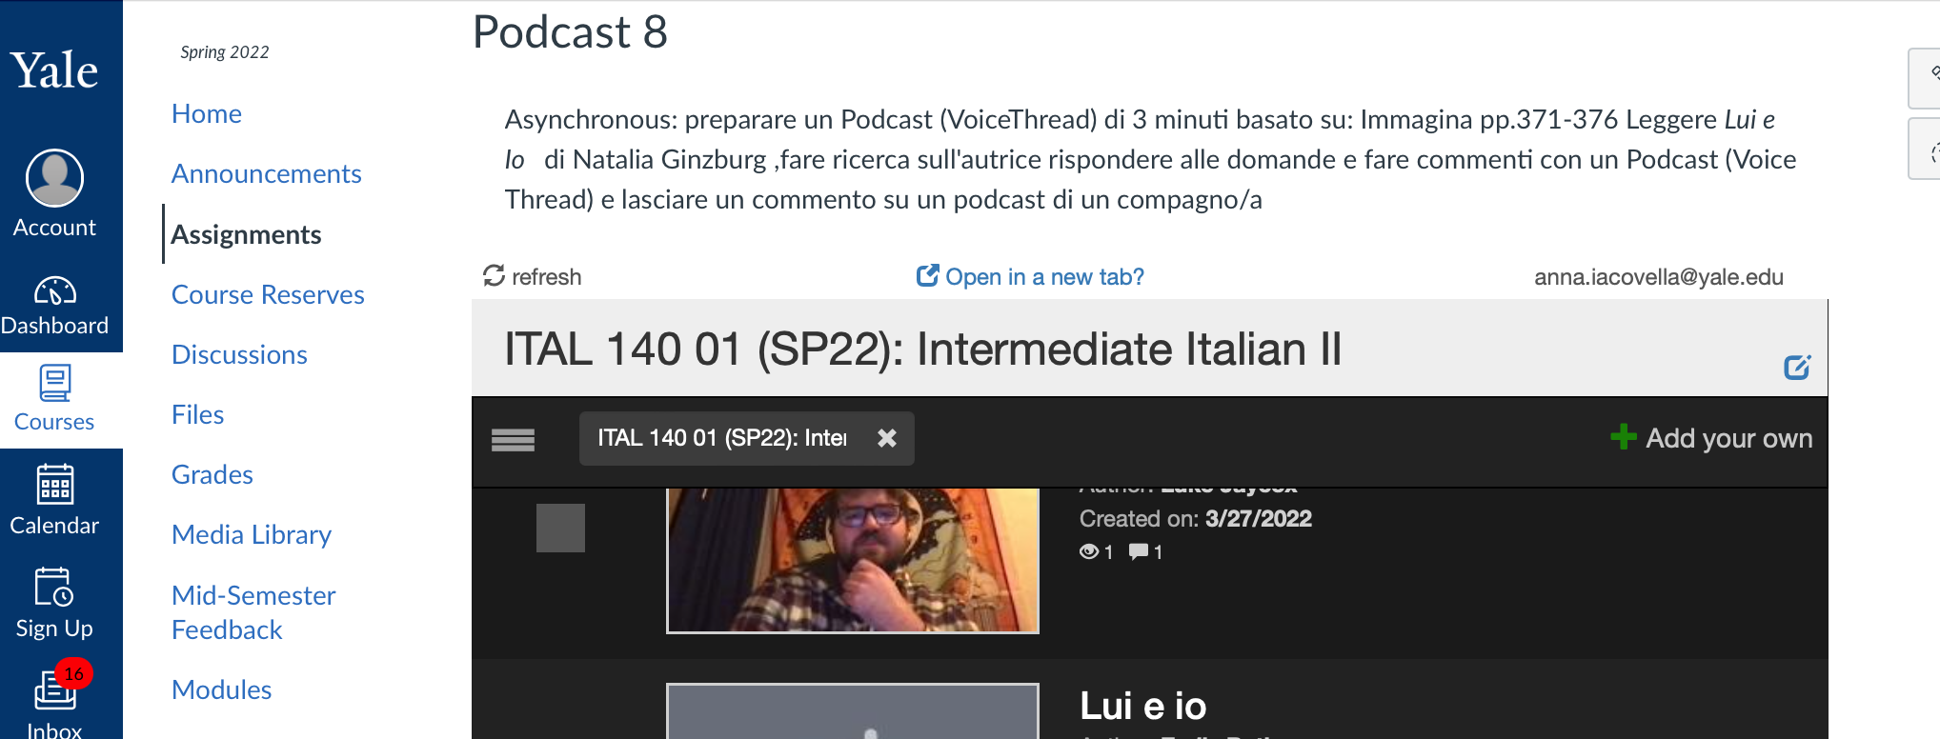
Podcast video & audio: following the reading of a literary passage
z

Slide 22
Some Reported benefits of asynchronous days: Students:
work at their own pace
take another class that met on the asynchronous day
feel more confident to report their work
reflect more on their assignments
take agency of their learning experience
appreciate the break in between in person classes
increased creativity
better attendance on synchronous days
No achievement differences between 4:1 and all synchronous

Slide 23
Citations
Iacovella, Anna, Pellegrino, Deborah & Lorenzini. Simona “Adapting and transferring interactive activities and skills from the in-person classroom into the Zoom meeting: a successful experience during the Covid-19 pandemic.”. Cultura & Comunicazione International Journal. Vol.11.18, 2021 pp. 36-39
Immagina 3rd edition,Vista Higer Learning
Mizza, Daria, and Fernando Rubio. Creating Effective Blended Language Learning Courses: A Research-Based Guide from Planning to Evaluation. Cambridge University Press, 2020.Sheninger, Eric. “Moving to a Hybrid Learning Model.” Moving to a Hybrid Learning Model, 21 June 2020,
http://esheninger.blogspot.com/2020/06/moving-to-hybrid learning- model.html.
https://www.codlearningtech.org/PDF/hybridteachingworkbook.pdf
Rubio, Fernando, and Joshua J. Thoms. "Hybrid language teaching and learning: Looking forward." (2012): 1-9.

Slide 24
Thank you! Grazie! Questions?

