Slide 1
ChatGPT
SHIVA RAHMANI
Assistant Instructional Professor of German
University of Chicago

Slide 2
David Autor (M.I.T. economist):
ChatGPT: A revolution in usefulness!
“Before, computers were powerful, but they simply and robotically did what people programmed them to do.” Generative artificial intelligence, on the other hand, is “adaptive, it learns and is capable of flexible problem solving.”

Slide 3
Agenda
Definition, brief history
The rationale for integrating Chatgpt into language Instruction
Benefits and & pedagogical aspects
Examples for users
(Latest developments)
Potential challenges & limitations
Practices and strategies for using ChatGPT in language instruction
Takeaways
Bibliography
Questions & Answers

Slide 4
Part 1
Definition, brief history & initial reactions

Slide 5
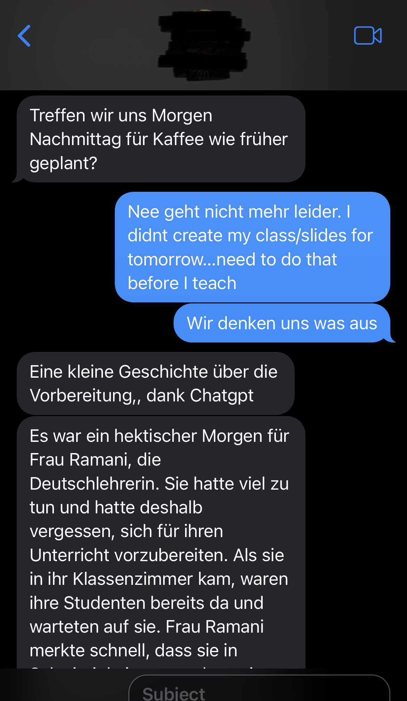
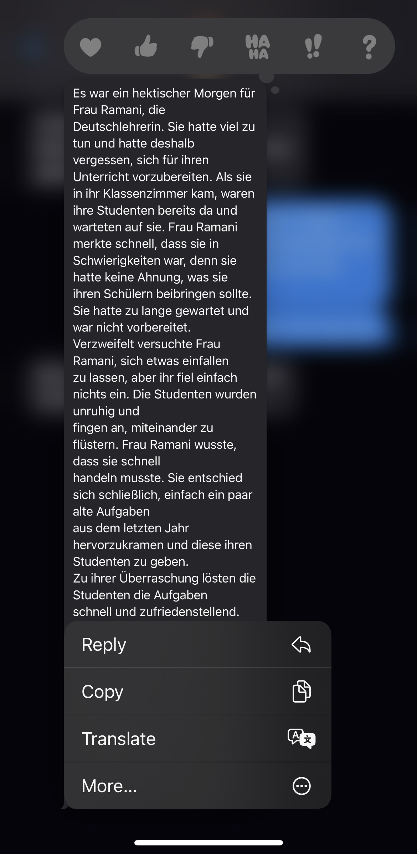
ChatGPT
ChatGPT: generative artificial intelligence- released on November 30, 2022, by the artificial intelligence lab OpenAI to mimic human-like conversations based on user prompts.
The chatbot generates eerily articulate and nuanced text in response to short prompts.
The dialogue format makes it possible for ChatGPT to answer follow-up questions, admit its mistakes, challenge incorrect premises, and reject inappropriate requests.
Background:
In September 2022: The LARC-MwALT-ECOLT conference (Language Assessment Research Conference held in conjunction with the Midwest Association of Language Testers, and East Coast Organization of Language Testers)
Notes:
https://www.cmswire.com/digital-experience/what-you-need-to-know-about-google-bard/. (google bard)
The theme for LARC-MwALT-ECOLT 2022 is ‘The Role of Assessment in Transforming Second Language Pedagogy’ and will examine the many ways that assessment can inform innovation and ultimately the transformation of language teaching practices.

Slide 6
ChatGPT (released on November 30, 2022)
Bing Chat (Microsoft)
Ernie Bot (the chatbot launched by Chinese tech giant Baidu) released on March 16, 2023
Google’s Bard (released on March 21, 2023)
Notes:
In February, Microsoft announced its integration of ChatGPT to its Bing search engine called Bing Chat. This chatbot has some major differences from ChatGPT, with the biggest difference being access to the entirety of the internet.

Slide 7
Part 2
Incorporating ChatGPT into language instruction: Rationale, implementation

Slide 8
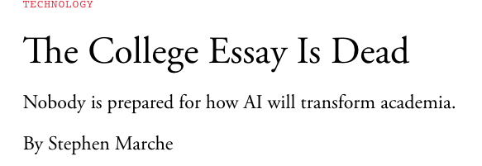
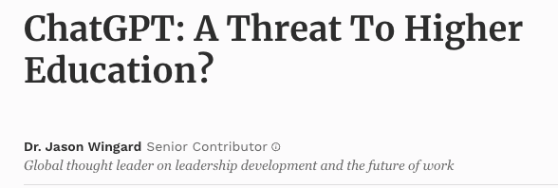
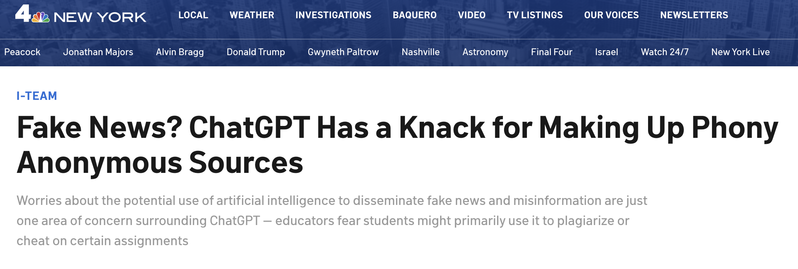

Slide 9
Why might students turn to ChatGPT or AI for coursework?

Slide 10
Desire for information without ads
Time constraints (lack of time or preparation): a way to save time and meet deadlines.
Stress
Lack of confidence: might provide them with a way to feel like they are making progress or getting the right answers.
Accessibility/instant feedback: Some students might not have access to other resources or support
Fear of failure/grade anxiety: Students might be afraid of failing their language coursework

Slide 11
Here are some reasons why instructors might/should consider using ChatGPT in their language classes
It is inevitable
01
Increased efficiency
07
Enhancing student engagement
02
Differentiated instruction
05
Enhanced language practice
03
Improving language proficiency
06
Access to authentic language: such as colloquial expressions or idioms.
04

Slide 12
Implementation:
Use
Use ChatGPT as a supplement to traditional language instruction methods
Create
Create custom assignments and prompts: Instructors can use ChatGPT to generate custom writing assignments and prompts that align with their specific learning objectives and goals.
Provide
Provide guidance and support: Instructors can use ChatGPT's feedback as a starting point for further discussion and feedback, helping students to understand how to improve their language skills over time.
Open openai.com
Click ChatGPT on the bottom left
Create an account and log in (if you have an account, log in directly)
Click “Try it now” at chat.openai.com.
Enter the question you need to query in the input box at the bottom

Slide 14
Part 3
Benefits and & pedagogical aspects

Slide 15
Benefits
Traditionally> manually assess student performance
With ChatGPT> instructors can use automated assessments to quickly and accurately evaluate student performance, allowing them to save time and focus on other aspects of instruction.
For students:
Efficacy
Instant feedback on language use
Increased engagement and motivation through interactive and dynamic language practice
Personalized and interactive language practice
Autonomous learning
Improved language proficiency through exposure to authentic language use
Cost-effectiveness
For Instructors:
Create study material
Stimulate brainstorming (generate prompts and ideas for language learning activities)
Can complement and enhance traditional language instruction methods
Greater flexibility in designing and delivering language instruction through technology integration
Time savings and increased efficiency through automated language assessment and feedback: can help instructors to be more effective in their teaching by providing them with tools that can automate routine tasks and provide students with instant feedback on their language use.

Slide 16
Part 4
ChatGPT examples for users

Slide 17
writing emails and letters
drafting a variety of forms
generating job postings
summaries
content for news articles
blog posts
social media posts
home listings
headlines

Slide 18
Calculate By ChatGPT

Slide 19
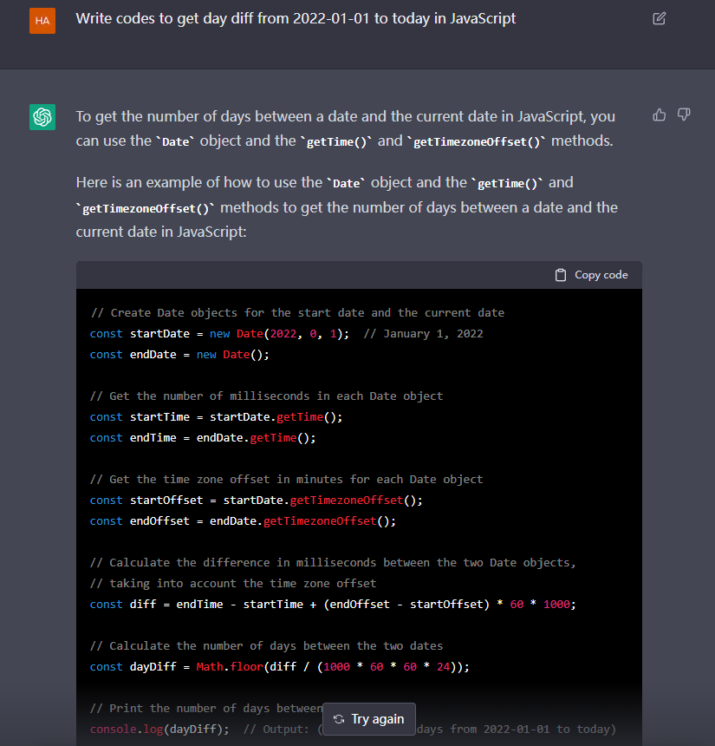
Coding By ChatGPT

Slide 20
Poem By ChatGPT

Slide 21
Shiva> In Farsi/Persian (for the Persian new year), write a short poem for my parents
Notes:
Rest on ChatGPT

Slide 22
History
Notes:
https://openai.com/blog/chatgpt/

Slide 23
ChatGPT in language instruction

Slide 24
Rules of Thumb for Genders
Nouns that end in "-er" or "-el" are usually masculine.
Nouns that end in "-ung", "-heit", or "-keit" are usually feminine.
Nouns that end in "-nis" or "-tät" can be either masculine or feminine.
Nouns that end in "-in" or "-ion" are usually feminine.
Nouns that end in "-schaft" are usually feminine
Nouns that end in "-chen" and "-lein" are usually neuter.
There are some exceptions to the above rules like for example: "der Tag", "das Jahr", "der Winter"

Slide 25
Accusative Prepositions
Preposition | Meaning | Example
bis | until | Ich warte bis zum nächsten Tag.
durch | through | Ich gehe durch den Park.
für | for | Ich kaufe das Buch für meine Schwester.
gegen | against | Ich kämpfe gegen meinen Gegner.
ohne | without | Ich gehe ins Kino ohne meine Freundin.
um | around | Ich laufe um den See.
entlang | along | Ich gehe entlang dem Fluss.

Slide 26
Dative Prepositions
Preposition | Meaning | Example
aus | out of | Ich gehe aus dem Haus.
bei | at | Ich bin bei meinen Eltern.
mit | with | Ich gehe mit meinem Freund.
nach | after | Ich gehe nach Hause.
seit | since | Ich warte seit einer Stunde.
von | from | Ich komme von der Arbeit.
zu | to | Ich gehe zur Schule.

Slide 27
Genitive Prepositions
Preposition | Meaning | Example
anstatt | instead of | Anstatt des Regens kam die Sonne.
aufgrund | due to | Aufgrund des Unfalls war die Straße gesperrt.
innerhalb | within | Innerhalb von einer Stunde kam er zurück.
trotz | despite | Trotz des schlechten Wetters gingen wir spazieren.
während | during | Während des Essens unterhielten wir uns.
wegen | because of | Wegen des Streiks blieb die Fabrik geschlossen.

Slide 28
Common Adjective Ending Rules
Adjectives that precede a noun usually have the same ending for all three genders (masculine, feminine, and neuter), and the form is based on the case and the number of the noun. In the nominative singular, the ending is usually "-e". In the accusative singular, the ending is usually "-en", and in the plural, the ending is usually "-en" for all cases.
In the genitive singular, the adjective usually takes the ending "-en" in all three genders.
In the dative singular, the adjective usually takes the ending "-en" for all three genders.
In the plural, the adjective usually takes the ending "-en" for all three cases (nominative, accusative, and dative).
Adjectives that follow the noun do not change the ending by case, gender or number and the adjective is always in the same form, which is the weak form.

Slide 29
Translate By ChatGPT

Slide 30
Language practice
Writing: prompts for writing exercises
Speaking: prompts for speaking exercises, role-plays, story writing/co-write a story
Feedback and correction: such as identifying errors in grammar or pronunciation
Language assessment: evaluating student’s writing and speaking proficiency + exams
Reading

Slide 31
Examples for writing

Slide 32
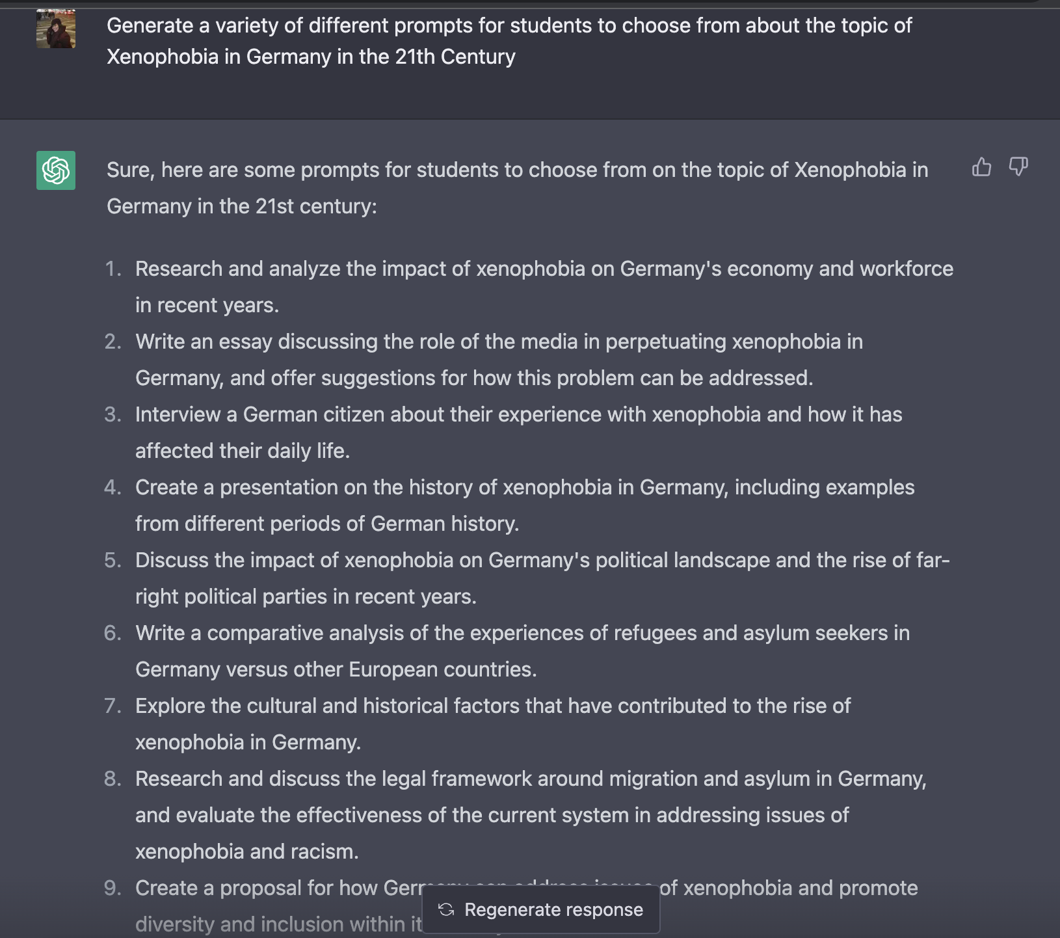
Language practice: Writing
Generating writing prompts for students
Benefits for students: This can help to stimulate brainstorming and encourage students to explore different ideas and perspectives, which can ultimately help them to develop their language skills more effectively.
Benefits for instructors: instructors can also save time and effort in creating lesson plans and activities.

Slide 33
To avoid plagiarism:
Modify the prompts to make them more specific: Instead of providing general prompts, instructors can provide prompts that require students to apply specific language skills and knowledge.
Add additional requirements to the assignment: Instructors can require students to incorporate specific vocabulary words or grammar structures, or to use a certain number of sources to complete their assignment.
Require students to submit multiple drafts: Requiring students to submit multiple drafts of their work can help to ensure that they are actively engaged in the writing process and are not simply relying on an AI tool to generate their work.
Use in-class writing assignments: Instructors can use in-class writing assignments as a way to assess students' language proficiency and to ensure that they are not relying solely on AI tools to complete their assignments.
5. Citing sources

Slide 34
Other examples
Use
Use it as a model: Students can use the generated essay as a model for their own writing, using it as a guide to understand the structure and organization of a well-written essay in German.
Use
Creative writing inspiration: Students can use the generated essay as inspiration for their own creative writing.
Practice
Practice Translation: Students can use the generated essay to practice translating German to English or vice versa.
Text: "Mein Tag" (My day)
Ich stehe jeden Morgen um sechs Uhr auf. Ich wasche mich, ziehe mich an und frühstücke dann. Um acht Uhr fahre ich mit dem Bus zur Arbeit. Ich arbeite als Lehrerin an einer Schule. Ich unterrichte Mathematik und Deutsch. Um eins Uhr esse ich Mittagessen in der Schulcafeteria. Nach der Arbeit fahre ich nach Hause. Ich koche Abendessen und esse mit meiner Familie. Um neun Uhr abends sehe ich fern oder lese ein Buch. Um zehn Uhr gehe ich ins Bett.
This text describes the daily routine of a person, it covers the main activities of the day, and it's written in simple German. It can be used in a German language classroom for reading comprehension and vocabulary practice.
For example, students could be asked to:
-Answer the questions based on the text
-Translate the text to their native language
-Write a summary of the text
-Create a similar text describing their own daily routine
-Identify the time expressions and the verb conjugations in the text
-Create questions to ask the person in the text

Slide 35
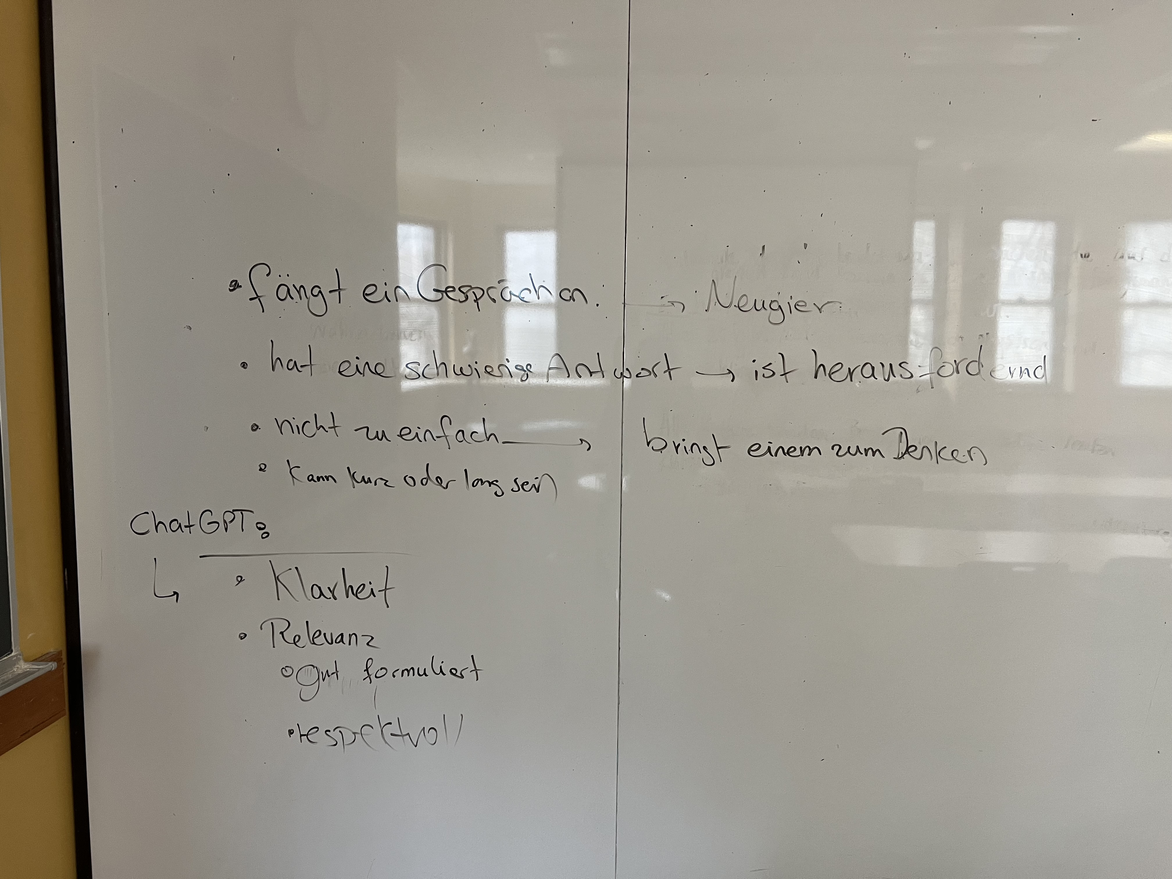
Brainstorming: Was macht eine gute Frage aus? Was beinhaltet es?

Slide 36
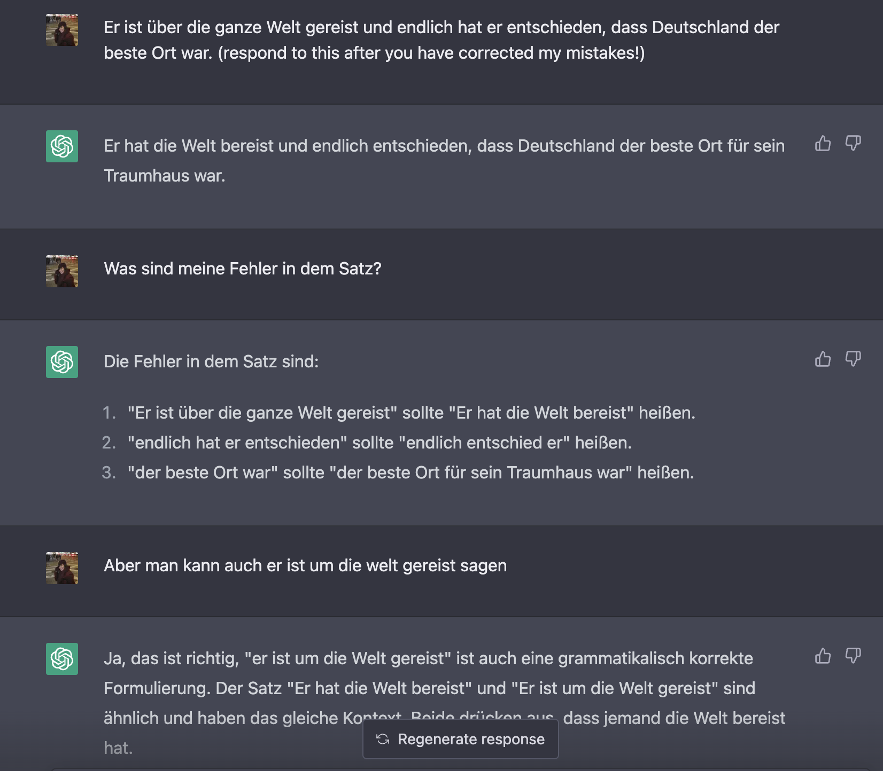
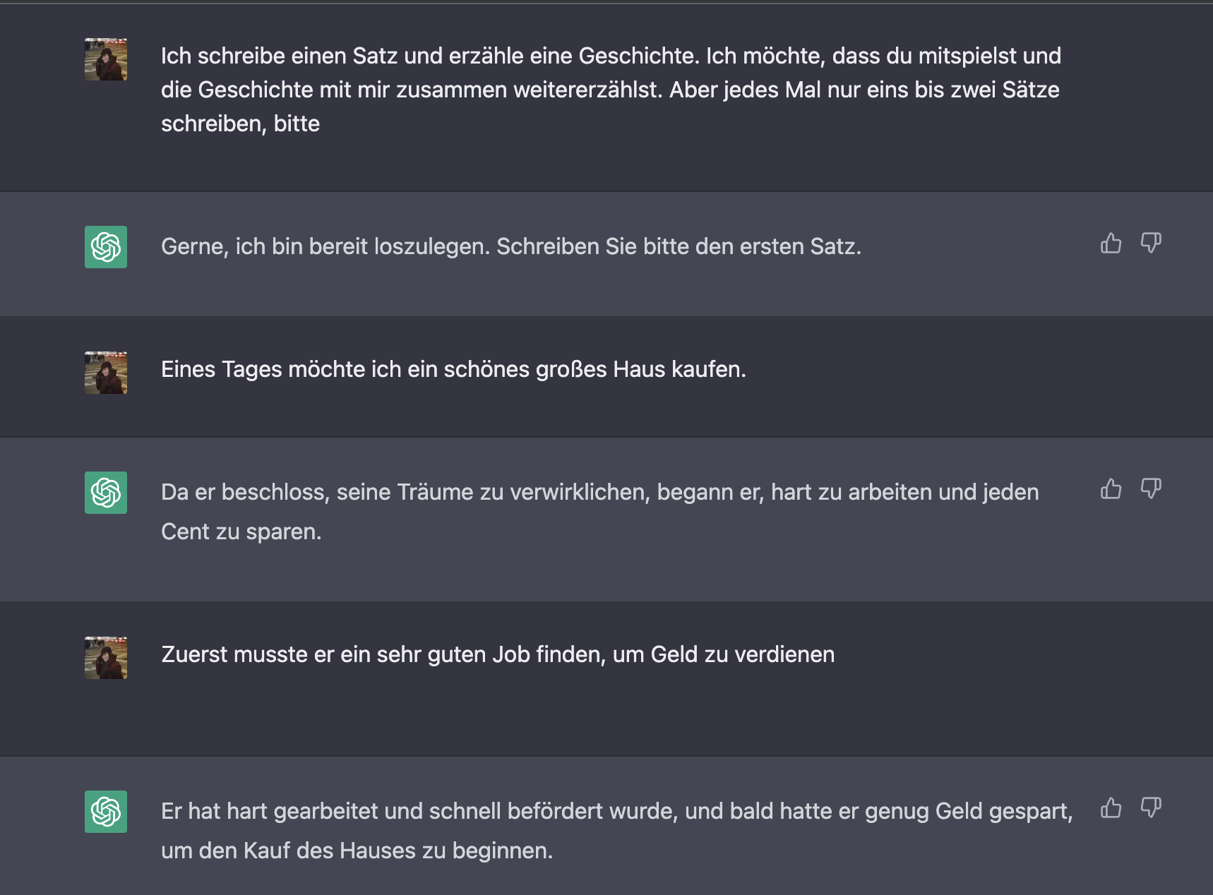
Co-writing a story

Slide 37
Examples for Speaking

Slide 38
Improving language proficiency and speaking
Personalized speaking practice
Pronunciation feedback: record speech and have the model transcribe the speech. The model can then provide feedback on any pronunciation errors and suggest corrections.
Vocabulary and grammar practice: Students can generate sentences with specific grammatical structures or vocabulary, and the model can provide feedback on any errors.
Role-playing: where students can practice their conversation skills in a fun and interactive way OR they could co-write a story with it!

Slide 39
Example (practice speaking in a conversational context) :
Tip:
” Let's do a role-play in German about our daily routines”
The more details you write in your prompts, the more precise the answers will be.
"daily routine" or "travel"
Students will have a conversation with ChatGPT on the topic, using the language they are learning.
For example:
Student: "Good morning, how are you?"
ChatGPT: "Good morning, I'm fine thank you. How about you?"
Student: "I'm good, thanks. So, what do you usually do in the morning?"
ChatGPT: "I usually wake up early, have breakfast, and then start my day. How about you?"
The teacher can observe the conversation and provide feedback on grammar, vocabulary, and pronunciation.

Slide 40
Discussions

Slide 41
Examples for reading

Slide 42
The teacher selects a passage or article related to the topic being studied in class.
Students read the passage or article and then answer questions about the text with the help of ChatGPT.
ChatGPT can provide assistance with:
-understanding complex words or sentences,
-help students to learn new vocabulary.
-paraphrasing
-help answer questions related to the text
-information on the context and background of the. topic
For example: Student: "What does the word 'prolific' mean in this sentence? 'He was a prolific writer'." ChatGPT: "The word 'prolific' in this sentence means 'producing a large amount of work' or 'having many accomplishments’” This can help improve their reading comprehension and their vocabulary.

Slide 43
ChatGPT can be used to improve reading comprehension by having students read passages and then answering questions about the text. The model can also help students to learn new words and understand the meaning of complex sentences.

Slide 44
Wir hören Musik!

Slide 45
Pre-listening activities: Dilla & emi x - Photosynthese
Analysieren und interpretieren Sie den folgenden Songtext!
Was ist das Thema?
Welche Bedeutung hat der Titel "Photosynthese" im Zusammenhang mit dem Text?
Welche Stimmung wird durch den Songtext erzeugt?
Welche Gefühle werden durch die beschriebenen Szenen und Situationen hervorgerufen?
Welche Botschaft vermittelt der Text?
Teilen Sie Ihre Gedanken und Meinungen darüber, was der Text ihrer Meinung nach bedeutet, und welche Botschaft er vermittelt.

Slide 46
Post-listening activities
https://lyricstranslate.com/en/dilla-germany-photosynthese-lyrics.html (Link zum Text auf Canvas)
https://www.youtube.com/watch?v=WtCOpg-JF1s&t=42s
Fragen während des Hörens/Sehens:
Was ist das Thema? Worüber sprechen die Sänger?
Welche Gefühle/Emotionen weckt das Lied (song) in Sie?
Welche Rolle spielen Musik und Chemie im Text?
Denken und sprechen Sie über ihre eigenen Erfahrungen mit nächtlichen Abenteuern und der Suche nach Wärme und Zugehörigkeit und bringen Sie diese mit dem Text in Verbindung.

Slide 47
ChatGPT Prompts: Latest Top 100 ChatGPT Commands Online

Slide 48
What is ChatGPT prompts？
ChatGPT prompts are used to input commands to ChatGPT, enabling it to generate natural language text.ChatGPT model is a large language model trained by OpenAI using NLP, so it needs corresponding text prompts to generate dialogue. If you don’t know how to enter Chatgpt commands during use, or want to see other people’s interesting commands, this article should help you. The ChatGPT prompts collected in this article were created by GitHub users, we are grateful to them, and you are also welcome to add your own prompts to the list!
https://chatgpt.pro/prompts/

Slide 49
Part 5
Potential challenges and limitations

Slide 50
Some limitations
During peak times, you may be unable to access ChatGPT. If you're seeing a message that it's at capacity, you can refresh the page, log out or or sign up to receive an email when it's available again.
The need for reliable internet connection
The possibility of over-reliance on technology
May occasionally generate incorrect information
May occasionally produce harmful instructions or biased content
Limited knowledge of events after 2021/not connected to the internet
Conversations may be reviewed by their AI trainers
blackout windows during peak times,
It's also NOT based on GPT-4
Notes:
OpenAI recommends users provide feedback on what ChatGPT tells them using the thumbs up and down buttons, in order to better improve the model.

Slide 51
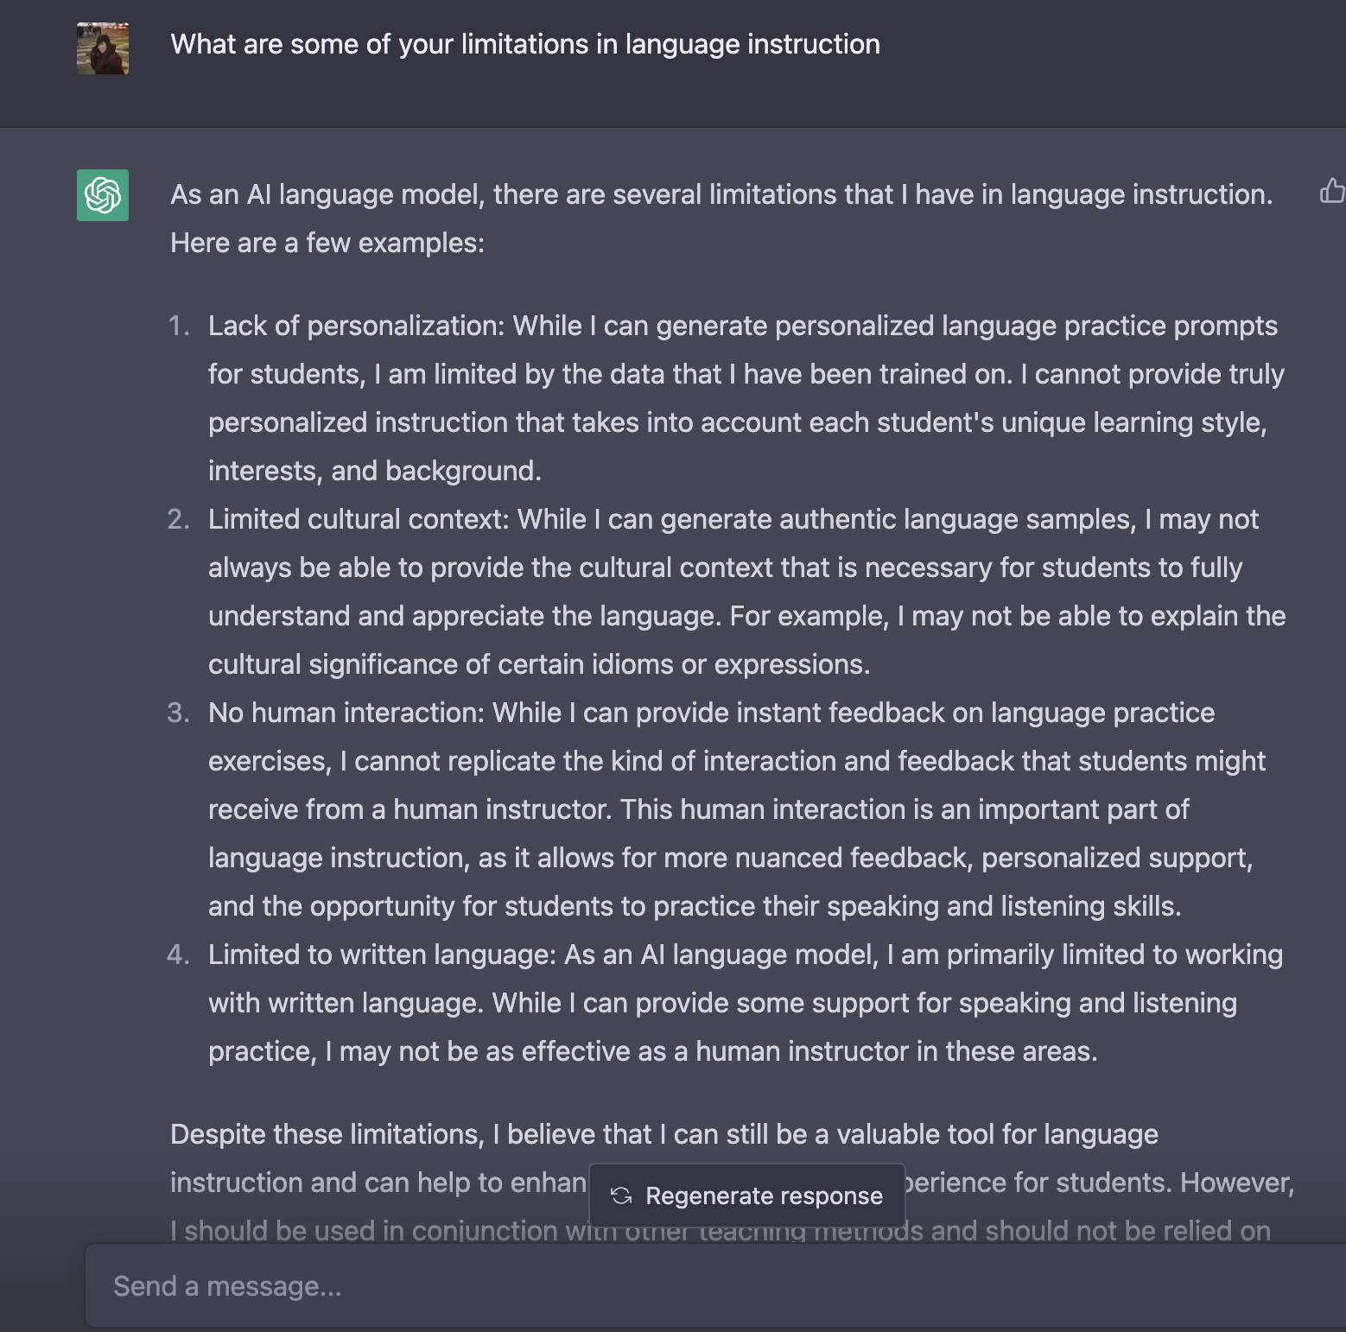
When I asked ChatGPT…

Slide 52
Part 6
Practices and strategies for using ChatGPT in language instruction

Slide 53
Some best practices and strategies for using ChatGPT in language instruction:
Set
Set clear learning objectives
Use
Use as a tool, not a replacement
Integrate
Integrate ChatGPT into lesson plans
Provide
Provide feedback and guidance
Encourage
Encourage collaboration
Be
Be aware of potential biases
Assess and adapt
Continuously assess and adapt

Slide 54
Part 7
Summary & Takeaways

Slide 55
Summary
One of the key features of ChatGPT is its ability to generate human-like text responses to prompts. It interacts with the user in a conversational way rather than delivering only facts.
It's just one part of a larger ecosystem of language learning software and tools.
They could be complements to human labor, rather than replacements.
The dialogue format makes it possible for ChatGPT to answer follow-up questions, admit its mistakes, challenge incorrect premises, and reject inappropriate requests.

Slide 56
Bibliography
ChatGPT passes Wharton Business School test: research paper: https://thehill.com/policy/technology/3825754-chatgpt-passes-wharton-business-school-test-research-paper/
Tinkering With ChatGPT, Workers Wonder: Will This Take My Job?: https://www.nytimes.com/2023/03/28/business/economy/jobs-ai-artificial-intelligence-chatgpt.html?unlocked_article_code=hP8pBAlcuqLfyebkyuFGoPZwpahmhgvFvJSWBqWgyB3H2NrgpQmrbRvNeEwLTnzd1yLPiQtAfXX44-nwG0ynMVXvz0tWcrWIR3YXtstknO2wzQhsqkc7MN1swYfj7hW_jzY6dmu2
How will Language Modelers like ChatGPT Affect Occupations and Industries?: https://papers.ssrn.com/sol3/papers.cfm?abstract_id=4375268
Experimental Evidence on the Productivity Effects of Generative Artificial Intelligence: https://economics.mit.edu/sites/default/files/inline-files/Noy_Zhang_1.pdf
The Impact of AI on Developer Productivity: Evidence from GitHub Copilot: https://arxiv.org/pdf/2302.06590.pdf
ChatGPT is coming for Google search: https://www.marketplace.org/shows/make-me-smart/chatgpt-is-coming-for-google-search/
https://chatgpt.pro/prompts/ (prompts)

Slide 57
Stoplight Self-Assessment

Slide 58
Thanks!
shivar@uchicago.edu

