Slide 1
The flipped classroom: how to overcome students’ resistance
NEALLT 2023
April 1 2023
Koji Tanno, University of Kentucky

Slide 2
OUTLINE
Flipped Classroom
Original course designs: Japanese courses
Issues with the normal designs
Improved course designs

Slide 3
INTRO: Flipped Classroom
Traditional Classroom:
Classroom for new knowledge > homework is for review
Flipped Classroom:
Homework for new knowledge > classroom for applying new knowledge

Slide 4
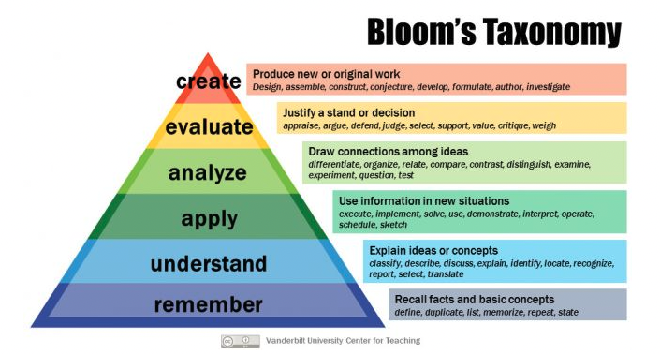
Why the flipped classroom?
Not enough time for more advanced class activities

Slide 5
University of Kentucky: 1st & 2nd year Japanese
Meeting 4 times a week (50 minutes)
Textbook: Genki 1＆ 2 (grammar-based textbook)
Homework:
Students watched a lecture video ( - 15 minutes)
Web App exercises (conjugation exercises, reading/listening exercises, writing sentences, translations)
In the classroom:
Review pattern drills
Open ended questions; work with classmates;
2nd-year: paragraph-level practice

Slide 6
Issue: Be aware of students’ expectations
Some students feel uncomfortable with the flipped classroom format
Flipped teaching is new to students
The purpose of flipped teaching
Passive stance toward learning
Self-guided study is also new to students
No study habit
Not following/reading instructions
No communication

Slide 7
Issue: Students want to listen to lectures
Mid-semester student feedback during 2020 Fall
“More directed classes on grammar and other mechanics or lecture-style classes would help the practice, preferably during in-person meetings.”
Agree 70% Disagree 10%
One student commented for mid-semester feedback:
“I think one extra meeting that would be live on zoom in lecture style geared towards teaching grammar would be very beneficial. This would help cater to student’s personal understanding of material as they could ask questions in the lecture. This may also cater to different learning styles (visual and audio).

Slide 8
Changes to the course designs
1 day of Quiz + Lecturing 3 new topics
Students can study for the quiz
Briefly introduce new concepts/topics
3 days of flipped classroom teaching
Preview homework + in-class activities
Interleaving: it involves mixing up topics within the same subject when studying.

Slide 9
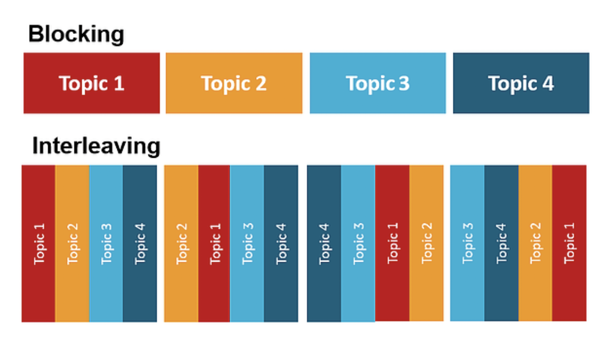
BLOCKING VS. INTERLEAVING
http://hkr-k.co.jp/publics/index/13/#page13

Slide 10
Benefits of interleaving
Improved academic performance & memory
Discriminating differences and similarities
Benefits of spacing for long-term memory

Slide 11
Design Change
Normal Flipped Classroom
Day 1
Day 2
Day 3
Day 4
Adopted Design
Day 3
Day 4
Day 1
Day 2

Slide 12
Conclusions
To overcome students’ resistance
Interleaving technique seems to be helpful
Preview homework and lecturing videos are still important

